Slide 1
UMD DATA605 - Big Data Systems NoSQL document stores MongoDB
CouchDB
GP Saggese
gsaggese@umd.edu
with thanks to
Alan Sussman (UMD)
Amol Deshpande (UMD)
Nguyen Vo (Utah State U.)
Kathleen Durant (Northeastern U.)

Slide 2
Key differentiators between NoSQL Stores
Data Model: Key-value, Wide-column, Document (JSON), Property Graph
Underlying architecture (e.g., Cassandra uses a P2P-style architecture underneath)
Replication scheme
Querying functionality
Cassandra has minimal query language, whereas MongoDB query language is much more functional and support aggregations and map-reduce

Slide 3
Key differentiators - CAP
By data model:
Relational systems are the databases we've been using for a long time. RDBMSs and systems that support ACID properties and joins are considered relational
Key-value systems basically support get, put, and delete operations based on a primary key
Column-oriented systems still use tables but have no joins (joins must be handled within your application). They store data by column as opposed to traditional row-oriented databases. This makes aggregations much easier.
Document-oriented systems store structured "documents" such as JSON or XML but have no joins (joins must be handled within your application). It's very easy to map data from object-oriented software to these systems.

Slide 4
Consistent, Partition-Tolerant (CP) Systems
Have trouble with availability while keeping data consistent across partitioned nodes
Examples include:
BigTable (column-oriented/tabular)
Hypertable (column-oriented/tabular)
HBase (column-oriented/tabular)
MongoDB (document-oriented)
Terrastore (document-oriented)
Redis (key-value)
Scalaris (key-value)
MemcacheDB (key-value)
Berkeley DB (key-value)

Slide 5
Available, Partition-Tolerant (AP) Systems
Achieve "eventual consistency" through replication and verification
Examples include:
AWS Dynamo (key-value)
Voldemort (key-value)
Tokyo Cabinet (key-value)
KAI (key-value)
Cassandra (column-oriented/tabular)
CouchDB (document-oriented)
SimpleDB (document-oriented)
Riak (document-oriented)

Slide 6
Key-Value vs Document DBs
Key-value is basically a map or dictionary
Uninterpreted value associated with a key
Generally can only look up values by key
Sometimes can do search in value field with a pattern
One namespace for all key-value pairs
Document DB collects sets of key-value pairs into documents
Typically represented in JSON, XML, or binary JSON
Documents organized into collections, similar to tables in RDBMSs
Entities within collections can be separated by type
Large collections can be partitioned, and indexed

Slide 7
UMD DATA605 - Big Data Systems NoSQL document stores MongoDB
CouchDB

Slide 8
What is MongoDB?
Developed by 10gen
Founded in 2007
A document-oriented, NoSQL database
Hash-based, schema-less database
No Data Definition Language
In practice, this means you can store hashes with any keys and values that you choose
Keys are a basic data type but in reality stored as strings
Document Identifiers (_id) will be created for each document, field name reserved by system
Application tracks the schema and mapping
Uses BSON format
Based on JSON – B stands for Binary
Written in C++
Supports APIs (drivers) in many computer languages
JavaScript, Python, Ruby, Perl, Java, Scala, C#, C++, Haskell, Erlang

Slide 9
Functionality of MongoDB
Dynamic schema
No Data Definition Language
Secondary indexes
Query language via an API
Atomic writes and fully-consistent reads
If system configured that way
Master-slave replication with automated failover (replica sets) - for high availability
Built-in horizontal scaling via automated range-based partitioning of data (sharding)
Reads and writes distributed over shards
No joins nor transactions (across multiple documents)
Makes distributed queries easy and fast
Notes:
What is dynamic schemas?

Slide 10
Why Use MongoDB?
Simple queries
Functionality provided applicable to most web applications
Easy and fast integration of data
Not well suited for heavy and complex transactions systems

Slide 11
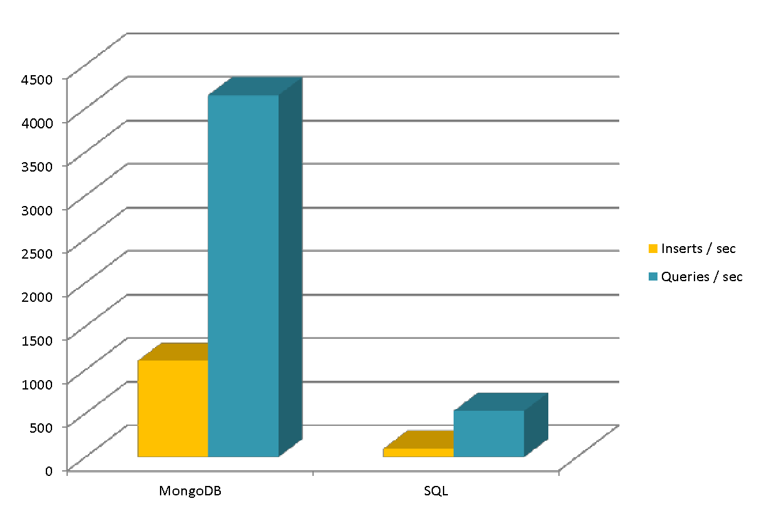
It is Fast!
Anywhere from 2X to 10X faster than MySQL

Slide 12
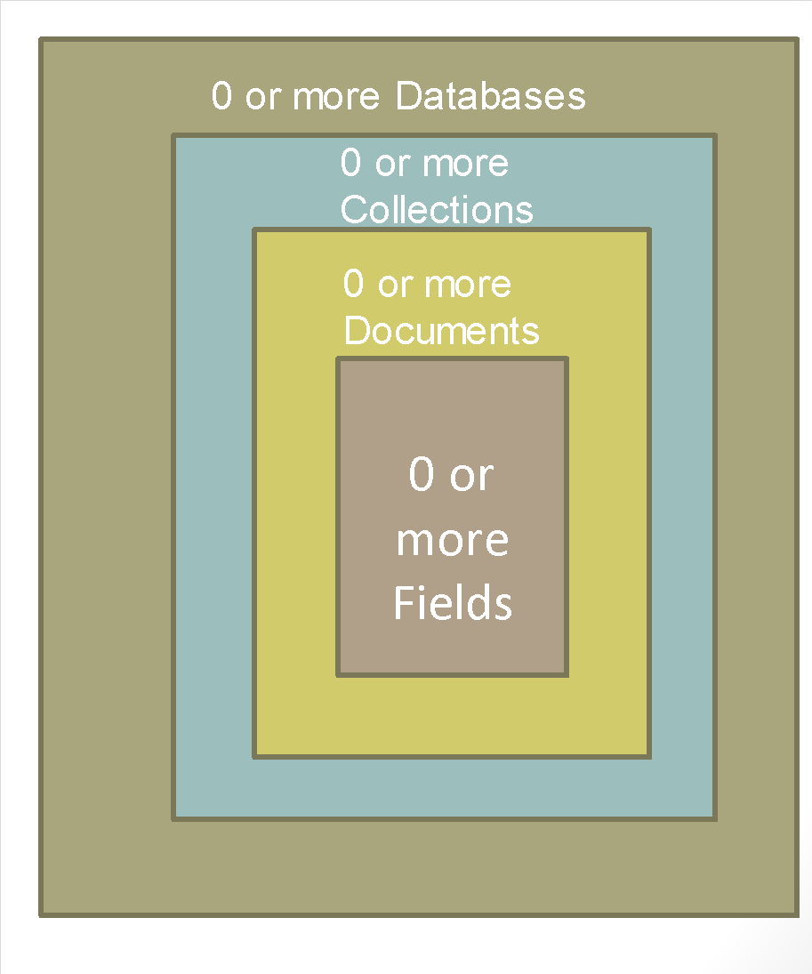
Hierarchical Objects
A MongoDB instance may have zero or more ‘databases’
A database may have zero or more ‘collections’
A collection may have zero or more ‘documents’
A document may have one or more ‘fields’
MongoDB ‘Indexes’ function much like their RDBMS counterparts

Slide 13
SQL vs MongoDB
SQL Terms/Concepts | MongoDB Terms/Concepts
database | database
table, view | collection
row | document (BSON)
column | field
index | index
table joins (e.g. select queries) | embedded documents and linking
Primary keys | _id field is always the primary key
Foreign key | reference
Notes:
What is the index in MongoDB
Embedded documents and linking??
Aggregation pipeline??
http://docs.mongodb.org/manual/core/data-model-design/

Slide 14
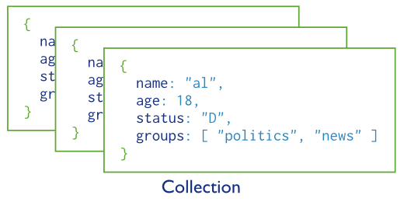
MongoDB Data Model
A collection includes documents.
Notes:
The schema is very flexible. Documents in each collection can have different structures.

Slide 15
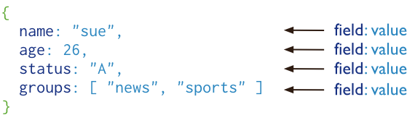
MongoDB Data Model
Structure of a JSON-document:
The value of field:
Native data types
Arrays
Other documents
Notes:
The schema is very flexible. Documents in each collection can have different structures.

Slide 16
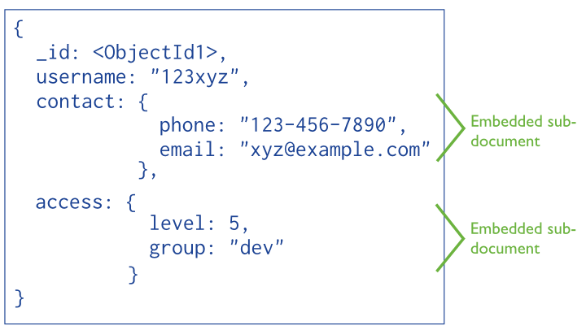
MongoDB Data Model
Embedded documents:
The primary key
Notes:
With embedded documents, we do not need complicated join table.
Why objectId1 – a hex string

Slide 17
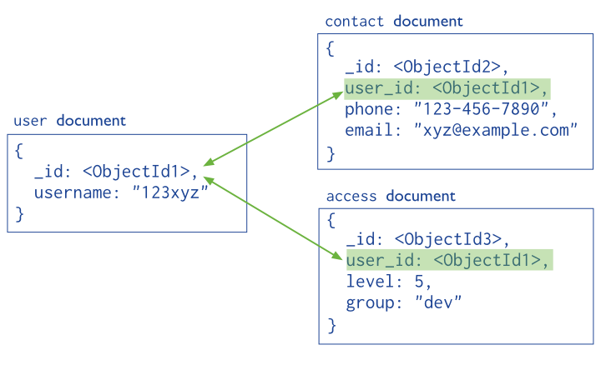
MongoDB Data Model
Reference documents or linking documents
Notes:
With embedded documents, we do not need complicated join table.
Why objectId1 – a hex string

Slide 18
MongoDB Processes and configuration
Mongod – Database instance (the server process)
Mongos – Sharding/partitioning processes
Analogous to a database router
Processes all requests
Decides how many and which mongods should receive the query
Mongos collates the results, and sends it back to the client
Mongo – an interactive shell (a client)
Fully functional JavaScript environment for use with a MongoDB
You can have one mongos for the whole system no matter how many mongods you have
OR you can have one local mongos for every client if you wanted to minimize network latency

Slide 19
Choices made for Design of MongoDB
Scale horizontally over commodity hardware
Lots of relatively inexpensive servers
Keep the functionality that works well in RDBMSs
Ad hoc queries
Fully featured indexes
Secondary indexes
What doesn’t distribute well in RDBMS?
Long running multi-row transactions
Joins
Both artifacts of the relational data model (row x column)

Slide 20
BSON format
Binary-encoded serialization of JSON-like documents
Zero or more key/value pairs are stored as a single entity
Each entry consists of a field name, a data type, and a value
Large elements in a BSON document are prefixed with a length field to facilitate scanning
Like JSON, supports embedding of objects and arrays within other objects and arrays (not just references)
MongoDB understands the internals of BSON objects, even nested ones, so can build indexes and match objects against query expressions for both top-level and nested BSON keys

Slide 21
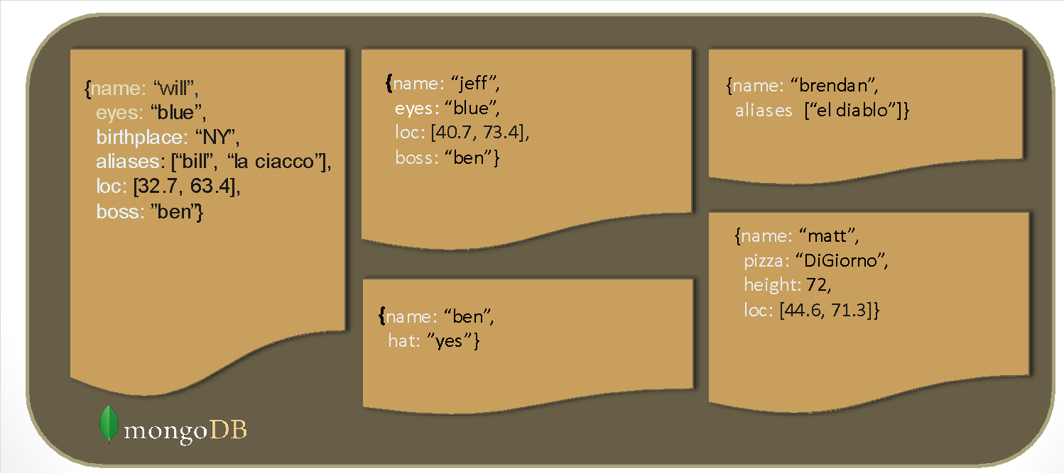
Schema Free
MongoDB does not need any pre-defined data schema
Every document in a collection could have different data
Addresses NULL data fields

Slide 22
JSON Format
Data is in name / value pairs
A name/value pair consists of a field name followed by a colon, followed by a value
Example: “name”: “R2-D2”
Data is separated by commas
Example: “name”: “R2-D2”, race : “Droid”
Curly braces hold objects
Example: {“name”: “R2-D2”, race : “Droid”, affiliation: “rebels”}
An array is stored in brackets []
Example: [ {“name”: “R2-D2”, race : “Droid”, affiliation: “rebels”}, {“name”: “Yoda”, affiliation: “rebels”} ]

Slide 23
MongoDB Features
Document-Oriented storage
Full Index Support
Replication & High Availability
Auto-Sharding
Querying
Fast In-Place Updates
Map/Reduce functionality
Claims to be Agile and Scalable

Slide 24
Indexes
B+ tree indexes
Index automatically created on the _id field (the primary key) – so per collection
Users can create other indexes to improve query performance or to enforce Unique values for a particular field
Supports single field index as well as Compound index
Like SQL, order of the fields in a compound index matters
If you index a field that holds an array value, MongoDB creates separate index entries for every element of the array
Sparse property of an index ensures that the index only contain entries for documents that have the indexed field (so ignores records that do not have the field defined)
If an index is both unique and sparse, then MongoDB will reject records that have a duplicate key value but allow records that do not have the indexed field defined

Slide 25
CRUD Operations
Create
db.collection.insert( <document> )
db.collection.save( <document> )
db.collection.update( <query>, <update>, { upsert: true } )
Read
db.collection.find( <query>, <projection> )
db.collection.findOne( <query>, <projection> )
Update
db.collection.update( <query>, <update>, <options> )
Delete
db.collection.remove( <query>, <justOne> )
Collection specifies the collection or the ‘table’ to store the document

Slide 26
Create Operations
db.collection specifies the collection or the ‘table’ to store the document
db.collection_name.insert( <document> )
Omit the _id field to have MongoDB generate a unique key
Example db.parts.insert( {{type: “screwdriver”, quantity: 15 } )
db.parts.insert({_id: 10, type: “hammer”, quantity: 1 })
db.collection_name.update( <query>, <update>, { upsert: true } )
Will update 1 or more records in a collection satisfying query
db.collection_name.save(<document>)
Updates an existing record or creates a new record

Slide 27
Read Operations
db.collection.find( <query>, <projection> ).cursor modified
Provides functionality similar to the SQL SELECT command
<query> where condition , <projection> fields in result set
Example: var PartsCursor= db.parts.find({parts: “hammer”}).limit(5)
Has cursors to handle a result set
Can modify the query to impose limits, skips, and sort orders
Can specify to return the ‘top’ number of records from the result set
db.collection.findOne( <query>, <projection> )

Slide 28
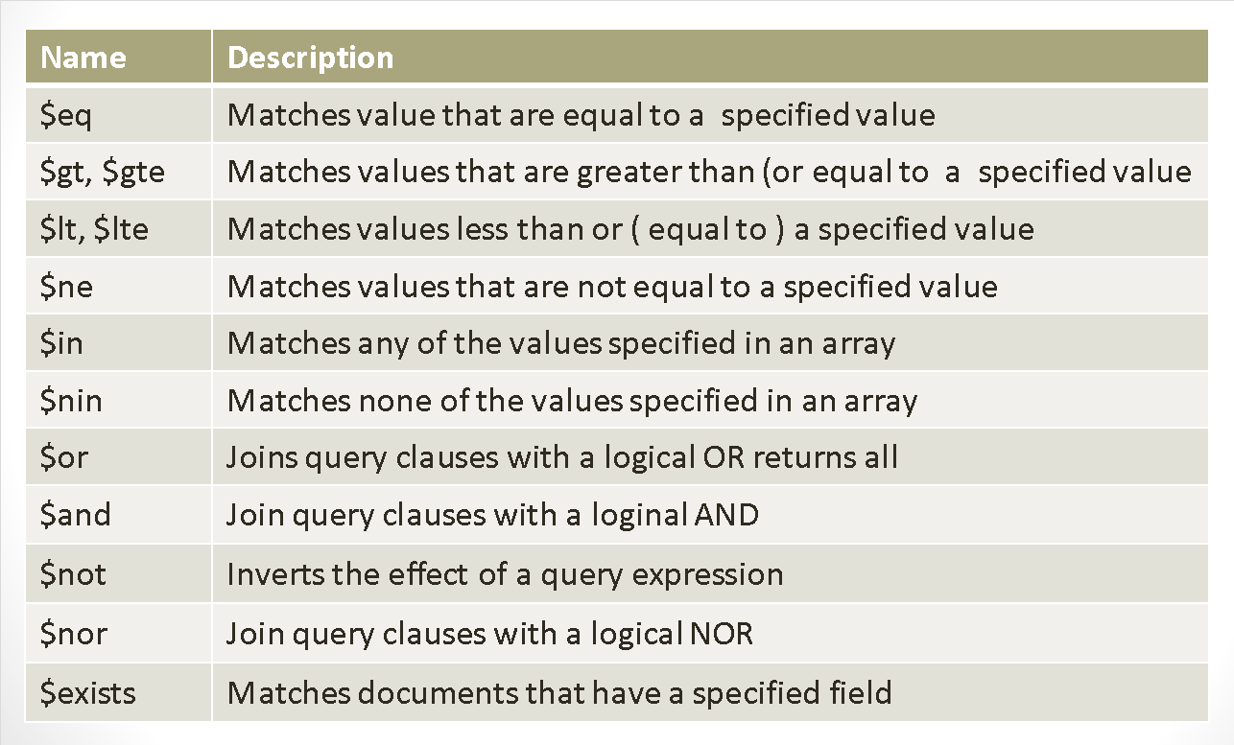
Query Operators
https://docs.mongodb.com/manual/reference/operator/query/index.html

Slide 29
Update Operations
db.collection_name.insert( <document> )
Omit the _id field to have MongoDB generate a unique key
Example: db.parts.insert( {{type: “screwdriver”, quantity: 15 } )
db.parts.insert({_id: 10, type: “hammer”, quantity: 1 })
db.collection_name.save( <document> )
Updates an existing record or creates a new record
db.collection_name.update( <query>, <update>, { upsert: true } )
Will update 1 or more records in a collection satisfying query
db.collection_name.findAndModify(<query>, <sort>, <update>,<new>, <fields>, <upsert>)
Modify existing record(s) – retrieve old or new version of the record

Slide 30
Delete Operations
db.collection_name.remove(<query>, <justone>)
Delete all records from a collection or matching a criterion
<justone> - specifies to delete only 1 record matching the criterion
Example: db.parts.remove(type: /^h/ } ) - remove all parts starting with h
Db.parts.remove() – delete all documents in the parts collections

Slide 31
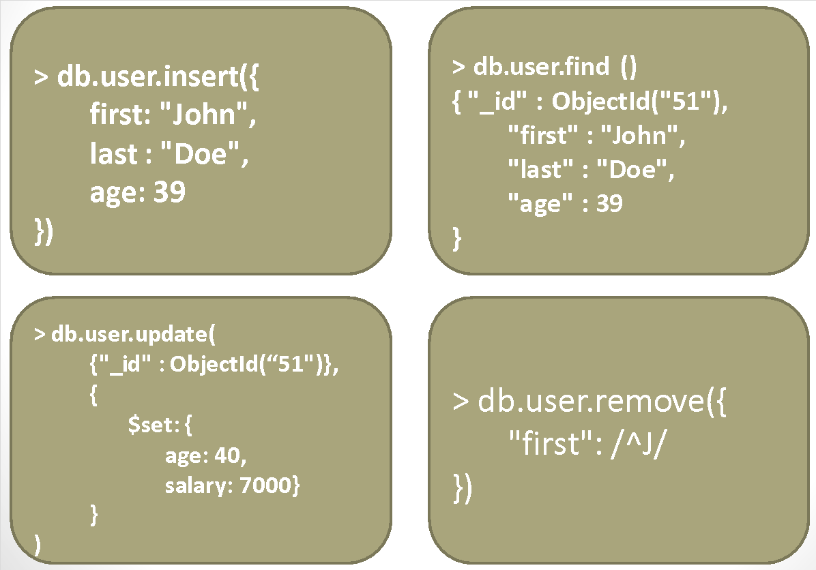
CRUD examples

Slide 32
More query examples
SELECT * FROM users WHERE age>33 db.users.find({age:{$gt:33}})
SELECT * FROM users WHERE age!=33 db.users.find({age:{$ne:33}})
SELECT * FROM users WHERE name LIKE "%Joe%" db.users.find({name:/Joe/})
SELECT * FROM users WHERE a=1 and b='q’ db.users.find({a:1,b:'q’})
SELECT * FROM users WHERE a=1 or b=2 db.users.find( { $or : [ { a : 1 } , { b : 2 } ] } )
SELECT * FROM foo WHERE name=‘bob’ and (a=1 or b=2 ) db.foo.find( { name : "bob" , $or : [ { a : 1 } , { b : 2 } ] } )
SELECT * FROM users WHERE age>33 AND age<=40 db.users.find({'age':{$gt:33,$lte:40}})

Slide 33
MapReduce functionality
Performs complex aggregator functions given a collection of keys, value pairs
Must provide at least a map function, reduction function and a name of the result set
db.collection.mapReduce( <mapfunction>, <reducefunction>, { out: <collection>, query: <document>, sort: <document>, limit: <number>, finalize: <function>, scope: <document>, jsMode: <boolean>, verbose: <boolean> } )

Slide 34
Replication of data
Ensures redundancy, backup, and automatic failover
Recovery manager in an RDMS
Replication occurs through groups of servers known as replica sets (for each shard)
Primary set – set of servers that client tasks direct updates to
Secondary set – set of servers used for duplication of data
Many different properties can be associated with a secondary set, i.e. secondary-only, hidden delayed, arbiters, non-voting
If the primary set fails the secondary sets ‘vote’ to elect the new primary set

Slide 35
Data Consistency
All writes and consistent reads go to the primary, and all eventually consistent reads are distributed among the secondaries
So client gets to decide how to enforce consistency for reads
All read operations issued to the primary of a replica set are consistent with the last write operation
Reads to a primary have strict consistency
Reads reflect the latest changes to the data
Reads to a secondary have eventual consistency
Updates propagate gradually
If clients permit reads from secondary sets – then client may read a previous state of the database
If failure occurs before the secondary nodes are updated
System identifies when a rollback needs to occur
Users are responsible for manually applying rollback changes

Slide 36
Query optimizer
Is not cost-based, like those for RDBMSs
MongoDB optimizer tries different query plans and learns which ones perform well
So a really bad plan may take a very long time to run
When testing new plans, MongoDB executes multiple query plans in parallel, and as soon as one finished the others are terminated
Because there are no joins, the space of query plans is not so huge
And if a plan that was working well starts performing poorly (e.g, data in the DB has changed, parameter values to a query are different), MongoDB will again try different plans

Slide 37
Limitations
No referential integrity
High degree of denormalization means updating something in many places instead of one
Lack of predefined schema is a double- edged sword
You must have a data model in your application
Objects within a collection can be completely inconsistent in their fields

Slide 38
Strengths
MongoDB is fast
Very little CPU overhead
Implemented in C++ for best performance
Very rapid development, open source
Useful when working with a huge quantity of data when the data's nature does not require a relational model
Can be used when what really matters is the ability to store and retrieve great quantities of data, not the relationships between the elements
Works on many platforms and there are many language drivers

Slide 39
MongoDB Summary
NoSQL built to address a distributed database system
Sharding
Replica sets of data
CAP Theorem: consistency, availability and partition tolerant - MongoDB mainly targets consistency and partition tolerance
MongoDB
Document oriented data, schema-less database, supports secondary indexes, provides a query language, consistent reads on primary sets
Lacks transactions, joins
https://www.mongodb.com

Slide 40
UMD DATA605 - Big Data Systems NoSQL document stores MongoDB
CouchDB

Slide 41
CouchDB
Another NoSQL document-oriented DB like MongoDB
Document is the storage unit
Combination of CouchDB and membase
CouchDB is an open source document store, with an HTTP RESTful API for reading and updating (add, edit, delete) database documents with all 4 ACID properties
membase was a distributed, key-value store designed to scale both up and down, and be highly available and partition tolerant
Uses HTTP protocol to query and interact with objects in the DB
Objects stored in buckets
Just a collection of documents (in JSON), with no special relation to one another
For CAP, get consistency and partition tolerance by default, high availability instead of consistency through use of multiple clusters

Slide 42
Architecture
Every Couchbase node consists of:
a data service
index service
query service
cluster manager component
The three services can be distributed to run on separate nodes of the cluster if needed
Data replication across the nodes of a cluster (and across data centers)
Data manager asynchronously writes data to disk after acknowledging to the client
Optionally can ensure data is written to more than one server or to disk before acknowledging a write to the client for failure tolerance

Slide 43
Queries
First define a view with the columns of the document your are interested in
Called the map
Then (optionally) define aggregate functions over the data
The reduce step
Can create multiple views over documents
Views are optimized/indexed by Couchbase for fast queries
Only re-indexed when underlying documents change a lot
So performs well when there are infrequent changes to the structure of documents
And know in advance what kinds of queries you want to execute
Uses a custom query language called N1QL, based on SQL
But runs on JSON documents
And queries over multiple documents using joins
Can also do full-text searches using the indexes

Slide 44
Why better than/different from MongoDB?
according to Couchbase advocates
MongoDB hard to scale from single replica set to fully distributed environment
MongoDB performance degrades with increasing numbers of clients/users
MongoDB susceptible to data loss from failures
MongoDB requires a 3rd party cache to help it perform well

Slide 45
Couchbase solves those problems
No master, with no single point of failure
Scales seamlessly, with an in-memory architecture, and able to scale across multiple nodes
During failover, prevents different nodes from accepting simultaneous reads of writes of same data (maintains consistency)
Has integrated in-memory cache (memcached)
Keeps frequently accessed documents, metadata, and indexes in RAM, yielding high read/write throughput at low latency

